Slide 1

Introduction to Python and Data Analysis
Day 1
Curro Campuzano Jimenez & Andrea Misiti
BIOMINA
University of Antwerp

Slide 2

What is Python?
General purpose programming language
Easy syntax
Readable code
Ideal starting point if you are new to programming

Slide 3

Python installation
Anaconda is a Python distribution that includes a GUI, several IDEs to choose from and a collection of commonly used packages.
Available for Windows, macOS and Linux
Beware of PATH issues on Windows. The advice is to not add conda to the Path and use Anaconda Command Prompt

Slide 4
A simple way to start with Python: Google Colab
Google Colab is a platform that allows you to freely run Python code (with some limitations)
It provides seamless Gemini integration for AI assistance chats and AI code editing / generation
Code is organised in notebooks

Slide 5
What is a notebook?
A Jupyter notebook is made up of cells, where each cell contains either text or code.
You can execute a code cell by hovering over it and clicking on the “play” button in the top left
You can execute cells in any order

Slide 6
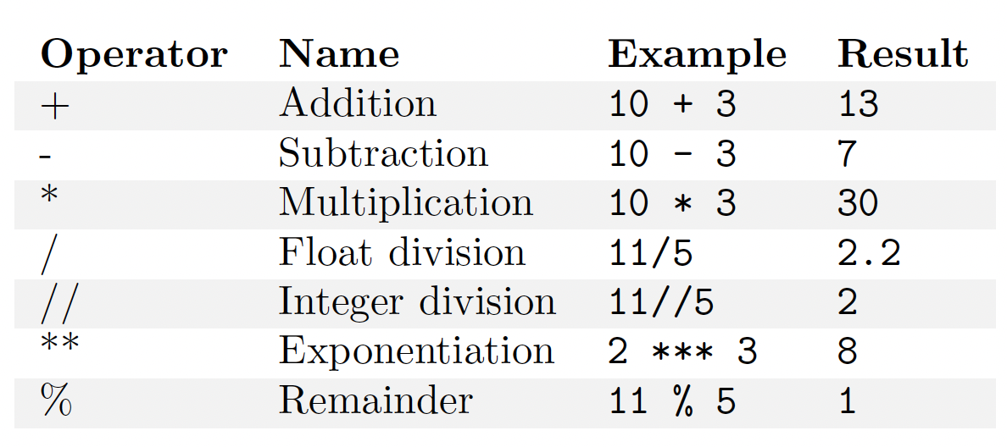
Using Python as a calculator: Arithmetic operators

Slide 7
An expression is a collection of any amount of numbers and operators.
An expression is evaluated according to the usual maths order of operations:
Parentheses > Exponentiation > Multiplication and Division > Addition and Subtraction

Slide 8
Some useful arithmetic functions
round(): converts a floating point (decimal) number to the nearest integer
abs(): computes the absolute value of a number
Functions are used (“called”) by writing their name followed by parentheses containing their arguments (some functions don’t require arguments)

Slide 9
Strings
Sequences of characters
Written between single (') or double (") quotation marks
The + operator concatenates (joins together) two strings
The * operator repeats a string multiple times
The len() function calculates the length (number of characters) in a string

Slide 10
Values and types recap
Integer (2)
Float (42.3)
String ("hello")
The type() function tells you what type a value is
Int(), float() and str() are functions that convert their argument to the specified type (if possible)

Slide 11
Variables
A variable is a name that refers to a value. To create a variable, you use an assignment statement
n = 17
Variables can be overwritten as many times as you like. The right hand side of the assignment is an expression that gets evaluated before the assignment takes place, so you can update a variable by referring to its current value in the right hand side expression (the variable has to be defined first)
n = n + 1

Slide 12
Modules and the import statement
Modules are collections of functions not included in core Python
Some of them are distributed with Python, most of them are external packages. You can even write your own!
Modules can be imported with the import statement
After importing them, you can access the functions they provide using dot notation
module.function

Slide 13
Displaying the value of expressions
In interactive environments like Jupyter notebooks and Colab, if an expression is written in the last line of a code cell it is automatically displayed in the cell’s output
To display other expressions or in non-interactive Python scripts you have to use the print() function

Slide 14
Defining new functions
You can define new functions using the following syntax:
def FUNCTION_NAME(PARAMETERS):
… function code …
return RETURN_VALUE
Indentation is important! By convention 4 spaces are used for each level of indentation
Parameters are variables that contain a function’s input values (arguments). They do not exist outside the function!
A function can have a return value or not

Slide 15
Why use functions?
They make for easier to read and debug programs
They avoid repeating the same code over and over
They allow you to build a complex program incrementally by breaking it down into simpler parts
They allow for code reusability across programs

Slide 16
Repetition and the range() function
You can execute code multiple times using the for statement:
for i in range(2):
print(i)
The variable you use to track the number of loops is called a counter.
The range() function is used to obtain a sequence of numbers (see notebook for details)

Slide 17
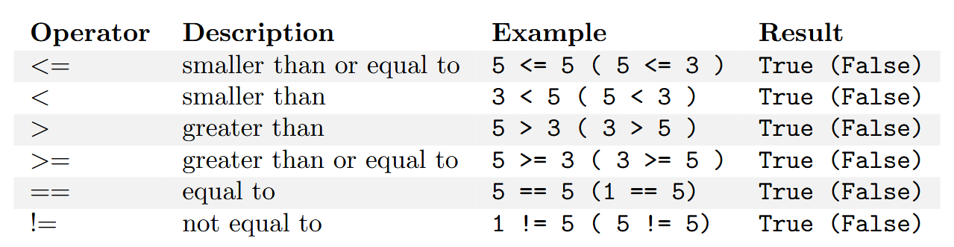
Boolean expressions
A boolean expression is an expression that is either True or False
Often, boolean expressions make use of relational operators
NOTE THE DOUBLE EQUAL SIGN for the equality test

Slide 18
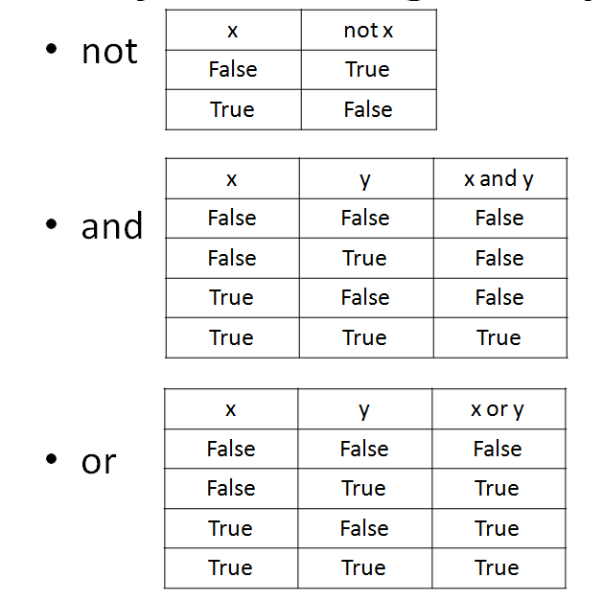
Logical operators
You can combine multilple boolean expressions together using logical operators
negates the expression
True if both expressions are true
True if at least one expression is true

Slide 19
if statements
Conditional (if) statements grant programs the ability to check conditions and change the behaviour of the program accordingly
The basic syntax is:
if BOOLEAN_EXPRESSION:
CODE TO BE EXECUTED IF CONDITION IS TRUE
else:
CODE TO BE EXECUTED IF THE CONDITION IS FALSE
The else branch is optional. Note again the indentation!

Slide 20
Strings
Strings are different from integers and floats because they are sequences of characters
You can access individual characters using square brackets, remembering that Python starts counting from 0!
"hello“[0] == "h"
You can use slices to select multiple characters. The right boundary is NOT included!
"hello“[1:4] == "ell"
Strings are IMMUTABLE

Slide 21
Some useful string methods
Methods are functions that are called by writing the name of a certain variable followed by a dot and then the name of the method
str.lower() returns an all-lowercase version of the original string
str.upper() returns an all-UPPERCASE version of the original string
str.replace(old, new) returns a new string in which a substring of the original string (a sequence of consecutive characters contained in it) is replaced by a new substring

Slide 22
The in operator and regular expressions
The in operator can be used to check for a simple substring presence in a string
Regular expressions allow to search more complex patterns. Some examples:
"stringA|stringB" allows for the matching of either stringA or string
"^" matches the beginning of a string
"$" matches the end of a string
"?" specifies that the preceding character in the regex is optional (can also not be in the string)
There are many more powerful features, ask an LLM!

Slide 23
Lists
A list is a sequence of values of any type. The values in a list are called elements
Lists are created using square brackets. l = [1, 2, 'hello', ['a string in another list'], 57]
The len() function returns the element count of the list
Elements can be accessed with the square bracket notation and using slices. Unlike strings, lists are mutable

Slide 24
List operations
The + operator concatenates list
['a', 'b'] + [1, 2] == ['a', 'b', 1, 2]
The * operator repeats a list a given number of times
['hello'] * 3 == ['hello', 'hello', 'hello']
The sum() function returns the sum of the elements in a list (provided they are all numbers)

Slide 25
List methods
Be careful! List methods usually modify the original list without returning it, unlike string methods.
list.append() adds an element at the end of the list
list.extend() takes another list as argument and appends each of its element to the original list
list.pop() removes and returns the element at the provided index
list.remove() removes (and doesn’t return) the specified element (by explicit reference)

Slide 26
Lists and strings
You can easily convert a string to a list of characters using the list() function
list("hello world") == ['h', 'e', 'l', 'l', 'o', ' ', 'w', 'o', 'r', 'l', 'd']
And vice versa using the str.join() method. The string you put before the dot is used as delimiter (can be empty for no delimiter)
'-'.join(['h', 'e', 'l', 'l', 'o', ' ', 'w', 'o', 'r', 'l', 'd’]) == 'h-e-l-l-o- -w-o-r-l-d’
The str.split() method can be used to divide a string at a specified delimiter, e.g. to get a list of single words
"this is a multi-word string".split(" ") == ["this", "is", "a", "multi-word", "string"]

Slide 27
Other list features
for statements loop over every element of a list
The sorted() function returns a sorted version of the input sequence (list or string)
The list.sort() method sorts a list in-place (without returning it)

Slide 28
Dictionaries
A dictionary is a generalized form of a list. You can see a dictionary as a list of values whose indices are not just integers, but any type*
The indices are called keys
Dictionaries are created by wrapping key: value pairs in curly braces
The in operator tells you if something is a key in the dictionary. Similarly, the for statement loops over keys as well
To access values you have to use the dict.values() method
* the key has to be of a hashable type. The definition of hashable is outside the scope of this course. For now it is sufficient to say that “simple” immutable types like ints and strings can be used as keys

Slide 29
Tuples
Tuples, like lists, are sequences of values indexed by integers, but they are immutable
They can be created by just listing comma-separated values, optionally enclosed by round parentheses. To create a one-element tuple you have to include a final comma.
Most list operations also work on tuples (e.g. bracket notation, slices, +, *, sorted)
Since tuples are immutable they can be used as dict keys.

Slide 30
Tuple packing and unpacking
Tuples can be put on both sides of an assignment statement.
a, b = 1, 2 -> a gets the value 1, b gets the value 2
This can be used to swap the values of two variables in a single line of code
a, b = b, a
Tuple packing is used to have functions return multiple values

